Slide 1
Introduction To Financial Management
Name: V Ashwitha
Roll No:125124672247

Slide 2

Introduction to Financial Management
Financial management is a vital function in any organization.
It involves planning, organizing, directing, and controlling financial activities.
Effective financial management helps in maximizing the value of the business.
Notes:
Image source: https://learnmech.com

Slide 3

Objectives of Financial Management
The primary objective is to maximize shareholder wealth.
Financial management aims to ensure the availability of funds when needed.
It also focuses on minimizing costs while optimizing financial resources.
Notes:
Image source: https://wealthquint.com

Slide 4

Financial Planning
Financial planning is the process of estimating future financial needs.
It includes budgeting and forecasting to support strategic goals.
A solid financial plan helps businesses navigate uncertainties effectively.
Notes:
Image source: https://static.fmgsuite.com

Slide 5
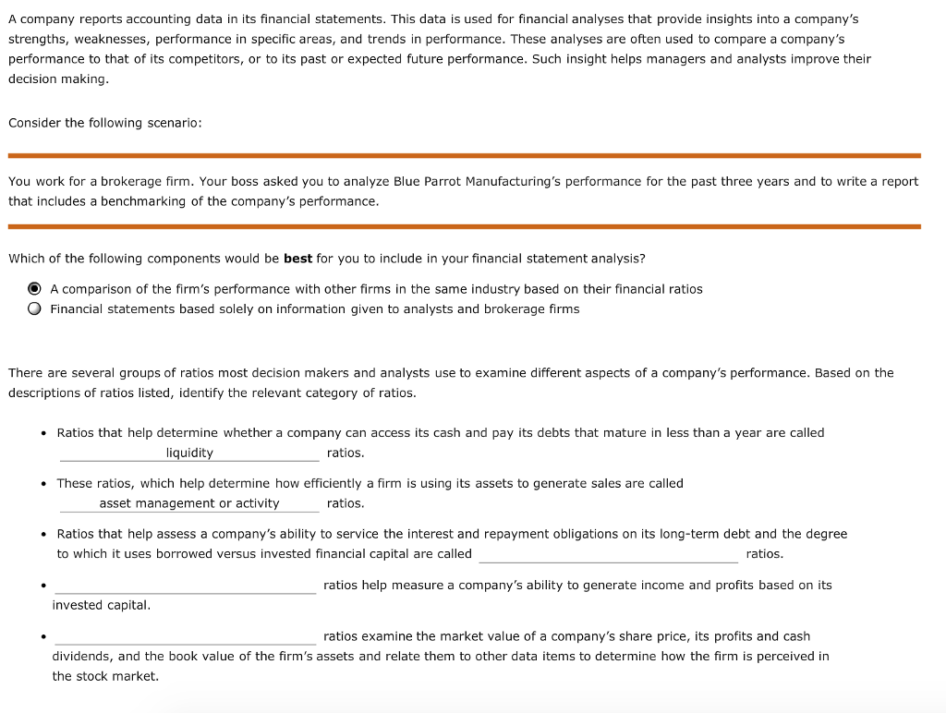
Financial Analysis
Financial analysis involves evaluating financial statements and ratios.
It helps determine the organization’s profitability, liquidity, and solvency.
By analyzing financial data, management can make informed decisions.
Notes:
Image source: https://media.cheggcdn.com

Slide 6
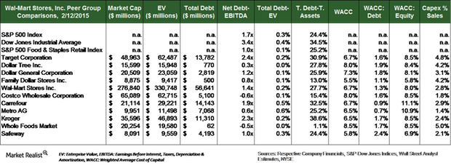
Capital Structure
Capital structure refers to the mix of debt and equity financing.
An optimal capital structure minimizes the cost of capital.
It balances risk and return to enhance the firm's value.
Notes:
Image source: https://media.marketrealist.com

Slide 7
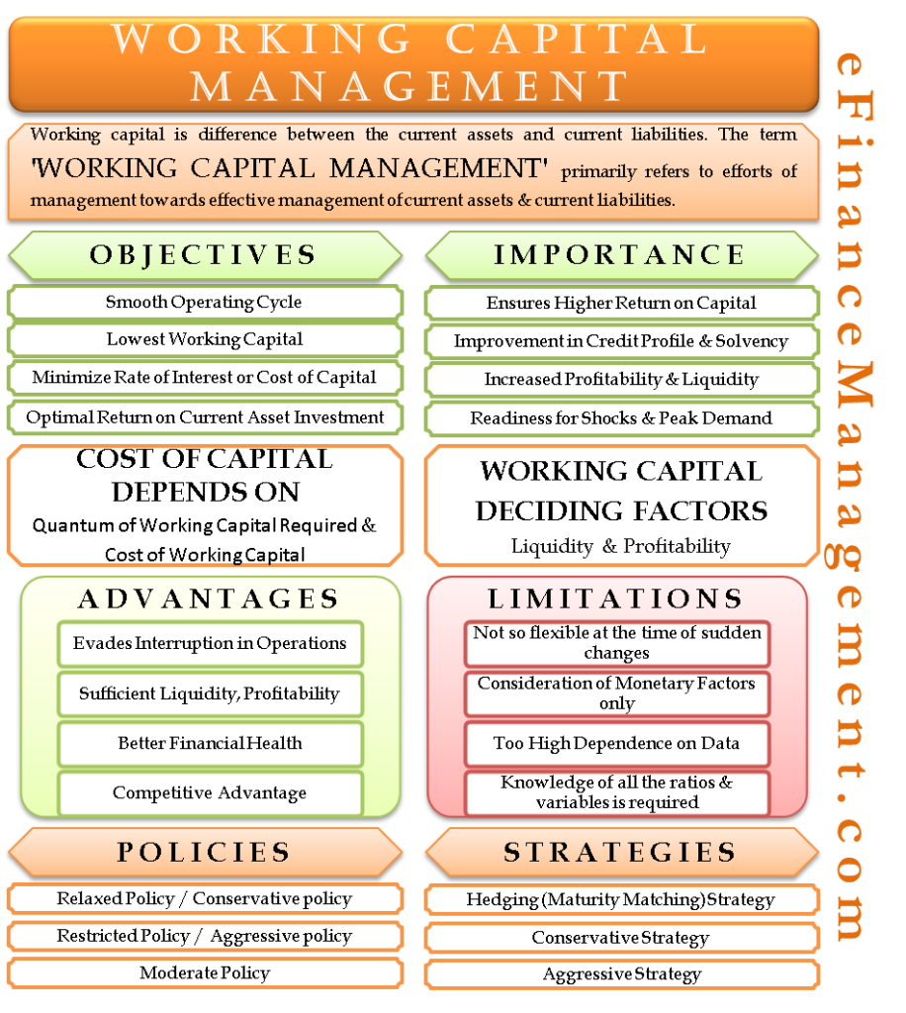
Working Capital Management
Working capital management ensures that a company has sufficient liquidity.
It involves managing current assets and liabilities effectively.
Proper management of working capital enhances operational efficiency.
Notes:
Image source: https://efinancemanagement.com

Slide 8
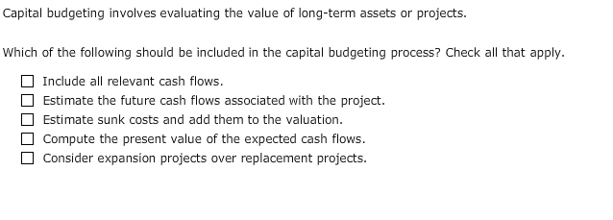
Investment Decisions
Investment decisions focus on the allocation of resources to long-term assets.
It involves evaluating potential projects through techniques like NPV and IRR.
Making sound investment decisions is crucial for long-term growth.
Notes:
Image source: https://d2vlcm61l7u1fs.cloudfront.net

Slide 9

Risk Management
Financial management includes identifying and mitigating financial risks.
It assesses risks related to market fluctuations, credit, and liquidity.
Effective risk management strategies protect the organization’s assets.
Notes:
Image source: https://as1.ftcdn.net

Slide 10
Financial Reporting
Financial reporting provides stakeholders with crucial information about performance.
It includes the preparation of financial statements in compliance with regulations.
Accurate reporting builds trust and transparency with investors and creditors.
Notes:
Image source: https://finance.gov.capital

Slide 11
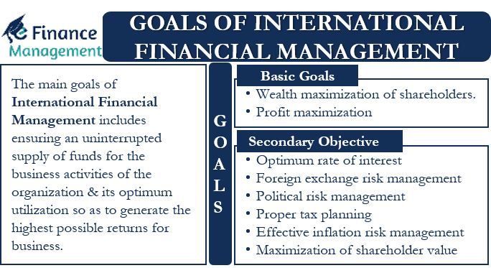
Conclusion
Financial management is essential for achieving an organization’s goals.
It integrates various financial activities for optimum performance.
Understanding its principles is key for anyone involved in business management.
Notes:
Image source: https://efinancemanagement.com

Slide 12
THANK
YOU

